Slide 1
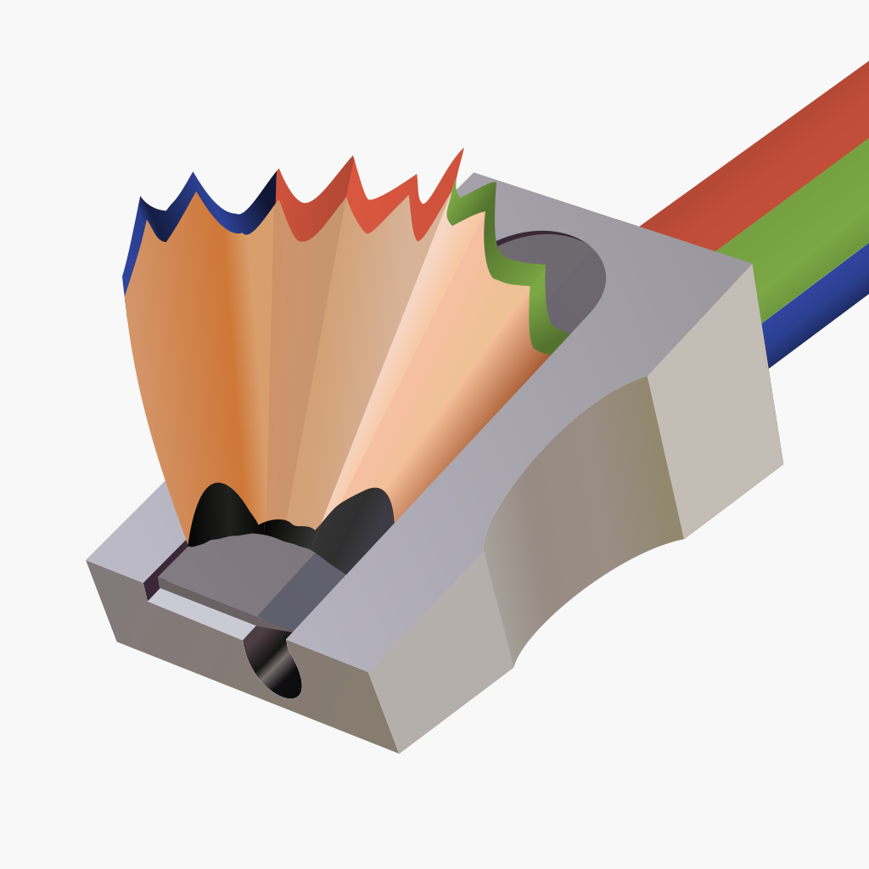
Blazor Native Interop with SkiaSharp
Matthew Leibowitz @mattleibow

Slide 2
Two “Native” Worlds
JavaScript
C/C++

Slide 3
JavaScript

Slide 4
Invoking a JavaScript method (Global Static)
C#
[Inject] IJSRuntime JS { get; set; }
await JS.InvokeVoidAsync("showAlert", "message text");
JS
window.showAlert = (message) => {
alert(`This is an alert: '${message}'`);
};

Slide 5
Invoking a JavaScript method (Module)
C#
[Inject] IJSRuntime JS { get; set; }
var module = await JS.InvokeAsync<IJSObjectReference>(
"import", "./js/MyInterop.js");
await module.InvokeVoidAsync("MyInterop.showAlert", "message text");
JS
export class MyInterop {
static showAlert(message) {
alert(`This is an alert: '${message}'`);
}
}

Slide 6
Invoking a .NET method (Global Static)
C#
[JSInvokable] // or [JSInvokable("<identifier>")]
public static async Task<string> ReverseText(string input)
{
return string.Concat(input.Reverse());
}
JS
let message = "Hello World";
DotNet.invokeMethodAsync('<assembly-name>', 'ReverseText', message)
.then((result) => {
alert(result);
});

Slide 7
Invoking a .NET method (Instance)
C#
var instance = new MyObject();
using var objRef = DotNetObjectReference.Create(instance);
await JS.InvokeVoidAsync("process", objRef);
class MyObjectType {
[JSInvokable]
public async Task<string> ReverseText(string message) =>
string.Concat(input.Reverse())
}
JS
window.process = (ref) => {
ref.invokeMethodAsync('ReverseText', message)
.then((result) => { alert(result); });
}

Slide 8
C/C++

Slide 9
Requirements
Install “.NET WebAssembly build tools” optional component
Enable native builds: <WasmBuildNative>true</WasmBuildNative>
Import the native file/library: <NativeFileReference Include="library.a" />

Slide 10
Invoking a C method (Global Static)
C#
var value = Multiply(2, 4);
[DllImport("file", EntryPoint = "multiply")]
extern static int Multiply(int a, int b);
C
int multiply(int a, int b) {
return a * b;
}

Slide 11
Invoking a C++ method (Instance)
C/C++
class MyClass
{
public:
MyClass(int value) { this->value = value; }
int getValue() { return this->value; }
private:
int value;
};
extern "C" {
void* my_class_new(int value) { return new MyClass(value); }
void my_class_delete(void* obj) { delete (MyClass*)obj; }
int my_class_get_value(void* obj) { return ((MyClass*)obj)->getValue(); }
}

Slide 12
Invoking a C++ method (Instance)
C#
var instance = my_class_new(10);
var value = my_class_get_value(instance);
my_class_delete(instance);
[DllImport("file")] extern static nint my_class_new(int value);
[DllImport("file")] extern static void my_class_delete(nint obj);
[DllImport("file")] extern static int my_class_get_value(nint obj);

Slide 13
Invoking a C++ method (Instance)
C#
using var instance = new MyClass(10);
var value = instance.Value;
class MyClass : IDisposable {
nint handle;
public MyClass(int value) {
handle = my_class_new(value);
}
public int Value => my_class_get_value(handle);
public void Dispose() => my_class_delete(handle);
}

Slide 14
SkiaSharp

Slide 15
What is skia?
A cross-platform graphics engine
Software rendering for bitmaps and PDF
Hardware rendering using OpenGL, DirectX, Vulkan and Metal
Written in Assembly, C, C++ and more
Powers Chromium, Chrome OS, Android, Firefox and more
Maintained and used by Google

Slide 16
What is SkiaSharp?
A .NET wrapper around skia
Supports most of the features of skia
Runs on almost all platforms
Provides software and hardware views
Written in C#
Maintained by Microsoft (and me!)

Slide 17
The 3 Parts of SkiaSharp
The SKSurface that abstracts the underlying platform surface
eg: GPU texture, memory block
The SKCanvas that translates drawing commands into basic operations for the surface
eg: DrawRect, DrawImage, DrawPath, Translate, Scale, Rotate
The SKPaint that describes what the drawn object will look like
eg: color, style, antialiasing, effects, filters, gradients

Slide 18
An Example
C#
// create a bitmap surface 256x256
using var surface = SKSurface.Create(new SKIageInfo(256, 256));
// get the canvas for the surface
var canvas = surface.Canvas;
// clear the canvas with a nice white
canvas.Clear(SKColors.White);
// create a solid red paint
using var paint = new SKPaint { Color = SKColors.Red, Style = SKPaintStyle.Fill };
// draw a 50x100 red rectangle at 10x30
canvas.DrawRect(SKRect.Create(10, 30, 50, 100), paint);

